Slide 1
Graphics Lecture 3
• 2D Geometric Transformations in Graphics
• 3D Graphics Fundamentals.
• 3D Viewing Pipeline
• 3D Graphics representation
Prof. .N.D.Kodikara, UCSC

Slide 2
Basic Geometric Transformations
• Translation
• Scaling
• Rotation
Prof. .N.D.Kodikara, UCSC

Slide 3
Translation
A translation is applied to an object by repositioning it along a straight line path from one coordinate location to another.
(x’ ,y’)
(x,y)
A point (x,y) is at a point (x’,y’) after the translation.
Then, x’=x+T_{x} ; y’=y+T_{y}
Where T_{x} and T_{y} are translation distances in x and y directions respectively.
Prof. N.D.Kodikara, UCSC

Slide 4
Scaling
A scaling transformation alters the size of an object.
If a point (x,y) is at (x’,y’) after the scaling, then
x’= x . S_{x} ; y’= y. S_{y}
Where S_{x} and S_{y} are scaling factors in x and y directions respectively.
Prof. .N.D.Kodikara, UCSC

Slide 5
Scaling
Suppose a point (xc,yc) should be remained unchanged after the scaling:
(xc,yc)
(xc,yc)
x’= (x-xc)*S_{x}+xc x’= x*S_{x}+ xc(1-S_{x})
y’= (y-yc)*S_{y} +yc y’= y*S_{y}+ yc(1-S_{y})
or
Prof. r.N.D.Kodikara, UCSC

Slide 6
Rotation
A 2D rotation is applied to an object by repositioning it along a circular path in the xy plane. A rotation should be about a specified point.
(x’,y’)
θ
(x,y)
Rotation about the origin (0,0)
x’= x*cos(θ) – y*sin (θ)
y’= x* sin (θ) + y*cos((θ)
Prof. .N.D.Kodikara, UCSC

Slide 7
Rotation
Rotation about an arbitrary point (xc,yc)
x’ = xc+ (x-xc)* cos(θ) – (y –yc)* sin(θ)
y’= yc + (x-xc)* sin(θ) + (y-yc)* cos(θ)
Prof. .N.D.Kodikara, UCSC

Slide 8
Matrix Representation of Basic Transformations
All three basic transformations can be given in a matrix for as
P’= M1 * P +M2
Eg:
Scaling with a fixed point (xc,yc)
x’ S_{x} 0 x xc(1-S_{x})
y’ 0 S_{y} y yc(1-S_{y})
=
+
Prof. r.N.D.Kodikara, UCSC

Slide 9
Homogeneous Coordinates and Matrix Representation
The advantage of representing transformations in matrix form is that a sequence of transformations can be represented as a single composite transformation matrix by multiplying the corresponding transformation matrices. This can be done only if M2=0.
eg: P’= A * P and P’’= B * P’ Then
P’’= (B*A) * P
(B*A) is the composite transformation
Prof. .N.D.Kodikara, UCSC

Slide 10
Homogeneous Coordinates and Matrix Representation
In order to represent all transformations (when M2≠0) in matrix form so that matrix multiplications can be used in a sequence of transformations, the transformation matrices should be expressed as 3x3 matrices. The 2D points (x,y) will be represented in homogeneous coordinates as a coordinate triple(x_{w},y_{w},w)
x= x_{w}/w and y=y_{w}/w
where w is a scaling factor.
Prof. .N.D.Kodikara, UCSC

Slide 11
Homogeneous Coordinates and Matrix Representation
Thus, a general homogeneous coordinate representation can be written as (w.x, w.y, w). For 2D geometric transformations, we can choose the homogeneous parameter w to be any non-zero value. Thus, there is an infinite number of equivalent homogeneous representations for each coordinate point (x,y).
In general, w=1 is used, representing a 2D point (x,y) in homogeneous coordinates as (x,y,1)
Prof. .N.D.Kodikara, UCSC

Slide 12
Homogeneous Coordinates and Matrix Representation
The basic transformations can be represented in matrix form using homogeneous coordinates as follows:
Translation:
x’ 1 0 T_{x} x
y’ 0 1 T_{y} y
1 0 0 1 1
P’ = T(T_{x},T_{y}) * P
=
Prof..N.D.Kodikara, UCSC

Slide 13
Homogeneous Coordinates and Matrix Representation
Scaling:
x’ Sx 0 0 x
y’ 0 Sy 0 y
1 0 0 1 1
P’ = S(Sx,Sy) * P
Scaling with a fixed point (xc,yc)
x’ Sx 0 xc(1-Sx) x
y’ 0 Sy yc(1-Sy) y
1 0 0 1 1
=
=
Prof..N.D.Kodikara, UCSC

Slide 14
Homogeneous Coordinates and Matrix Representation
Rotation about the origin
x’ cos(θ) - sin(θ) 0 x
y’ sin(θ) cos(θ) 0 y
1 0 0 1 1
P’ = R(θ) * P
Rotation about an arbitrary point (xc,yc)
x’ …… ……… …………….…. x
y’ ……. ………. …………….….. y
1 ……. ………. ……………..…. 1
=
=
Prof..N.D.Kodikara, UCSC

Slide 15
Homogeneous Coordinates and Matrix Representation
Composite Transformations:
Prove that R(θ1) * R(θ2) = R(θ1+ θ2)
cos(θ1) -sin (θ1) 0 cos(θ2) -sin (θ2) 0
R(θ1) * R(θ2) = sin (θ1) cos(θ1) 0 sin (θ2) cos(θ2) 0
0 0 1 0 0 1
cos(θ1) cos(θ2) - sin (θ1) sin (θ2) -(cos (θ1) sin (θ2)+sin(θ1) cos(θ2)) 0
= cos (θ1) sin (θ2)+sin(θ1) cos(θ2) cos(θ1) cos(θ2) - sin (θ1) sin (θ2) 0
0 0 1
Prof. .N.D.Kodikara, UCSC

Slide 16
Homogeneous Coordinates and Matrix Representation
cos(θ1+ θ2) - sin (θ1+ θ2) 0
R(θ1) * R(θ2) = sin (θ1+ θ2) cos(θ1+ θ2) 0
0 0 1
=R (θ1+ θ2)
Prof. .N.D.Kodikara, UCSC

Slide 17
Homogeneous Coordinates and Matrix Representation
Prove that apart from some trivial cases there are no cases in 2D a rotation followed by a translation produces the same result as the given translation followed by the given rotation.
There are some non-trivial cases in 2D, a translation followed by a scaling produces the same result as the given scaling followed by the given translation. Identify these non-trivial cases.
Prove that a scaling followed by a rotation produces the same result as the given rotation followed by the given scaling.
Prove that a straight line remains as a straight line after the three basic transformations.
Prof. .N.D.Kodikara, UCSC

Slide 18
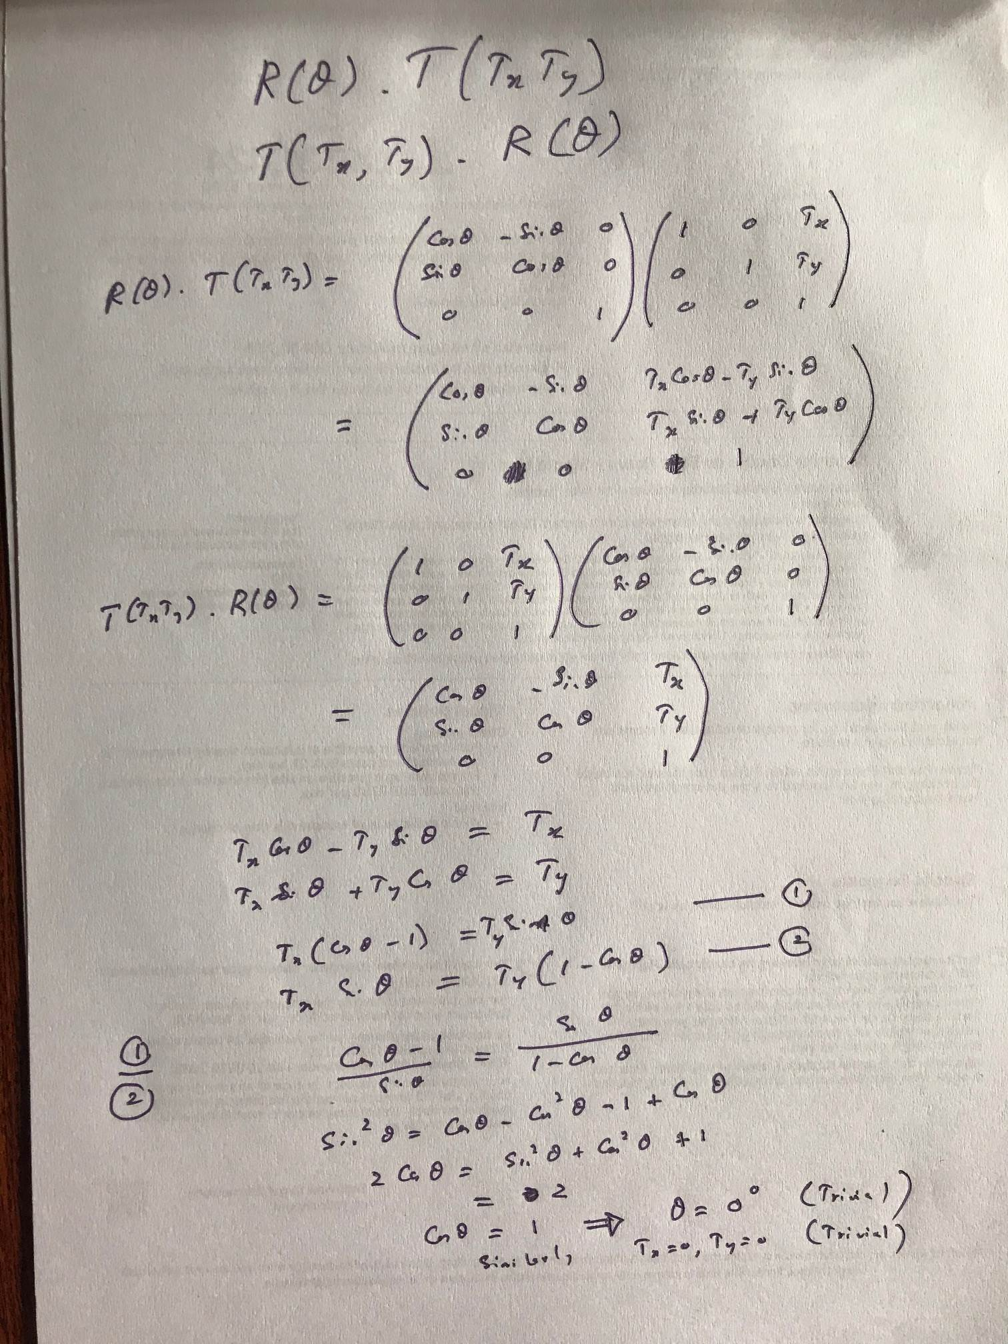
Prof. N.D.Kodikara

Slide 19
Other Geometric Transformations
Reflections.
A reflection is a transformation that produces a mirror image of an object relative to an axis of reflection.
Y
(x,y)
Reflection relative to
x-axis
x
(x’,y’)
x’= x
y’ = -y
Prof. .N.D.Kodikara, UCSC

Slide 20
Reflection
Give the reflection relative to x-axis in matrix form
x’ … … … x
y’ … … … y
1 … … … 1
Give the reflection relative to y=x line in matrix form
x’ … … … x
y’ … … … y
1 … … … 1
=
=
Prof. .N.D.Kodikara, UCSC

Slide 21
Shearing
A shear transformation distorts the shape of an object such that the transformed shape appears as if the object was composed of internal layers that had been caused to slide over each other.
(0,1) (1,1)
(2,1) (3,1)
(0,0) (1,0)
(0,0) (1,0)
X-direction shear can be given by x’= x+sh_{x}* y; y’ =y
1 sh_{x} 0
0 1 0
0 0 1
Where sh_{x} is the shearing factor in x-direction. In the above diagram sh_{x} =2.
Prof. .N.D.Kodikara, UCSC

Slide 22
Shearing
Shearing in y-direction
(1,3)
(0,1) (1,1)
(0,1)
(1,2)
(0,0) (1,0)
(0,0) (1,0)
The above shearing transformation can be given as
X’= x ; y’= sh_{y}*x +y 1 0 0
sh_{y} 1 0
0 0 1
In the above diagram sh_{y} = 2
Dr.N.D.Kodikara, UCSC

Slide 23
Review questions
Obtained the composite transformation matrix for a x-direction shear followed by a y-direction shear.
If a triangle with coordinates (1,1), (0,4) and (3,8) is transformed using the transformation in (1) with sh_{x}=2 and sh_{y}=2, obtained the new triangle. Draw both the original and the transformed triangle.
If the original triangle given in (2) is reflected with respect to y=x line, after the transformation given in (2) ,obtained the composite transformation matrix. Draw the new triangle.
Prof..N.D.Kodikara, UCSC

Slide 24
Three Dimensional Graphics
Three Dimensional Coordinate System
Y
Y
Z
X
X
Z
Right Handed System Left Handed System
Prof..N.D.Kodikara, UCSC

Slide 25
Projecting 3D Objects onto a 2D View Plane
Although various three dimensional display devices exist, most Computer Graphics view surfaces are two dimensional. Thus processes which convert three dimensional world coordinate space to a two dimensional representation are needed.
Because of the viewing surface in Computer Graphics is deemed to be flat, we consider a class of projections known as planer geometric projections. Two basic projections which are used in Computer Graphics are:
1. Perspective Projection
2. Parallel Projection.
Prof..N.D.Kodikara, UCSC

Slide 26
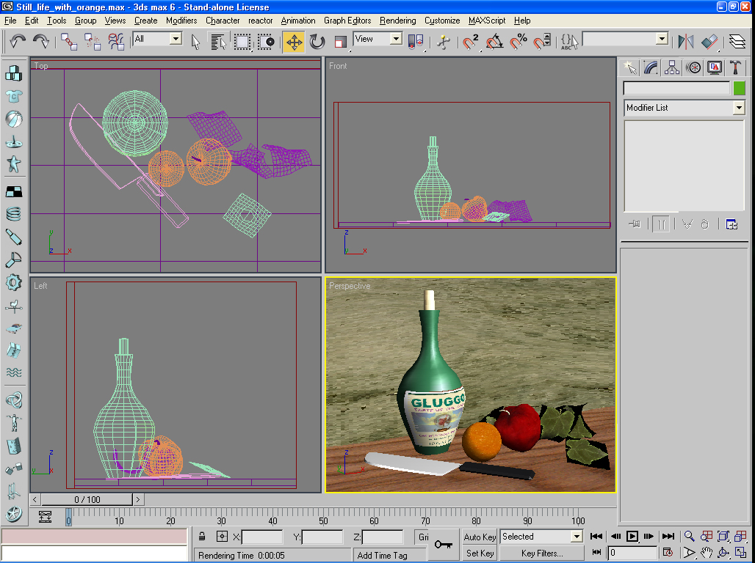
Dr.N.D.Kodikara, UCSC

Slide 27
Parallel Projection
In Parallel Projection, projections are made parallel to the view plane. If a parallel projection is perpendicular to the view plane, then it is referred to as Orthogonal Projection
P1
P1’
P2’
P2
View Plane
Prof..N.D.Kodikara, UCSC

Slide 28
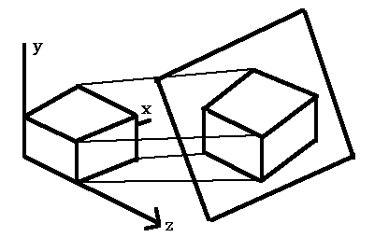
Parallel Projection
Prof..N.D.Kodikara, UCSC

Slide 29
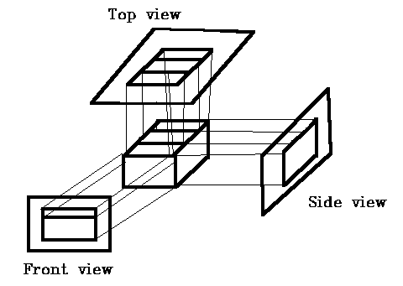
Parallel Orthogonal Projection
Prof..N.D.Kodikara, UCSC

Slide 30
Parallel Orthogonal Projection
Y
P
(x,y,z)
P’
(x’,y’,z’)
y
y’
x
x’
d
Z
z
X
Prof..N.D.Kodikara, UCSC

Slide 31
Parallel Orthogonal Projection
x’=x; y’=y; z’=d
In homogeneous matrix form
x’ 1 0 0 0 x
y’ 0 1 0 0 y
z’ 0 0 0 d z
1 0 0 0 1 1
=
Prof..N.D.Kodikara, UCSC

Slide 32
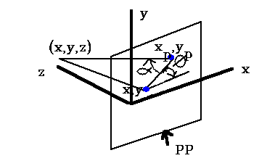
Parallel Oblique Projection
If the parallel projection is at an angle (α) to the view plane then the projection is called Oblique Projection
Prof..N.D.Kodikara, UCSC

Slide 33
Perspective Projection
A perspective projection is characterized by a point known as the center of projection (projection reference point) and the projection of three dimensional points onto the view plane is the intersection of the lines from each point to the center of projection with the view plane.
P1
P1’
Center of projection
P2’
P2
View Plane
Prof..N.D.Kodikara, UCSC

Slide 34
Perspective Projection
The perspective projection is the most popular or common choice in Computer Graphics because it incorporate foreshortening. In perspective projection, relative dimensions are not preserved, and a distant line is displayed smaller than a nearer line of the same length.
P1P2=P3P4
P1’P2’<P3’P4’
P1
P1
P1’
P1’
P3’
P3
P2’
P2’
P2
P4’
P2
P4
View Plane
View Plane
Prof..N.D.Kodikara, UCSC

Slide 35
Perspective Projection
Looking along the y-axis
X
P
P’
x
x’
COP (assume origin)
d
Z
z
View plane
Similar triangles gives x/x’= z/d ; x’ =x .d/z
Prof. .N.D.Kodikara, UCSC

Slide 36
Perspective Projection
Looking along the x-axis
Y
P
P’
y
y’
COP (assume origin)
d
Z
z
View plane
Similar triangles gives y/y’= z/d ; y’ =y .d/z
Prof. .N.D.Kodikara, UCSC

Slide 37
Perspective Projection
x’ =x .d/z; y’ =y .d/z; z’ = d
In homogeneous matrix form
x’ d/z 0 0 0 x
y’ 0 d/z 0 0 y
z’ 0 0 0 d z
1 0 0 0 1 1
=
Prof. .N.D.Kodikara, UCSC

Slide 38
3D View Volumes
A finite volume is obtained by limiting the extent of the volume in the z direction which is called the view volume. This is done by specifying positions for one or two additional boundary planes. These boundary planes are referred to as back (far) plane and front(near plane).
Parallel Projection
View volume
View Plane
Back plane
Front plane
Prof. .N.D.Kodikara, UCSC

Slide 39
3D View Volumes
Perspective Projection
View Volume
View plane
Back plane
Center of projection
Front plane
Prof. .N.D.Kodikara, UCSC

Slide 40
3D Viewing Pipeline
The complete series of transformations involved in going from three dimensional world coordinates to a display on a view surface is usually referred to as the three dimensional viewing pipeline.
This is a set of standard transformations, some of the components of which are set by the user, with others that are invincible to the user.
Prof. .N.D.Kodikara, UCSC

Slide 41
3D Viewing Pipeline
World coordinates 3D
Transform into view volume
View coordinates 3D
Clip against the view volume
View coordinates 3D
Project onto view plane
View coordinates 2D
Map onto viewport
Normalised device coordinates
Transform onto physical display device
Physical device coordinates
Prof. .N.D.Kodikara, UCSC

Slide 42
3D Viewing Pipeline
The first operation is the viewing transformation taking vertices in the world coordinates into viewing coordinates. The second operation clipping, eliminates the graphics outside the specified view volume. Then the appropriate projection transformation to project 3D graphics in the view volume onto the view plane should be carried out.
The final two steps in this pipeline are the standard final processes in a two dimensional pipeline. These involve transforming the view window contents on to the viewport ( the part of the display surface selected) and then transforming these coordinates into physical device coordinates.
Prof. .N.D.Kodikara, UCSC

Slide 43
3D Graphics Representation
Polygon Surfaces
The most commonly used object representation in 3D graphics is the surface polygons. This simplifies and speed up the surface rendering and display of objects, since all surfaces are described with linear equations.
In order to represent complex objects many packages use parametric curves and surfaces that are then converted to polygonal representation for processing.
Prof. .N.D.Kodikara, UCSC

Slide 44
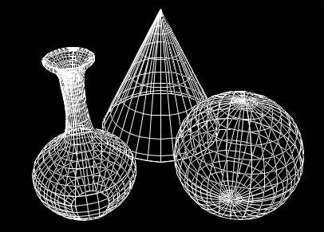
3D Graphics - Wire Frame
Prof. .N.D.Kodikara, UCSC

Slide 45
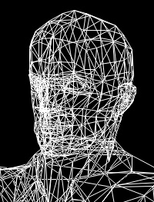
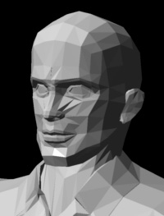
3D Graphics - Triangularization
Prof..N.D.Kodikara, UCSC

Slide 46
Polygon Tables
V1
E1
E3
E6
S1
S2
E2
V3
V5
V2
E4
Vertex Table
V1 : x1,y1,z1
V2 : x2,y2,z2
V3 : x3,y3,z3
V4 : x4,y4,z4
V5 : x5,y5,z5
E5
V4
Edge Table
E1 : V1,V2
E2 : V2,V3
E3 : V1, V3
E4 : V3, V4
E5 : V4,V5
E6 : V1,V5
Surface Table
S1 : E1,E2,E3
S2 : E3,E4,E5,E6
Prof. .N.D.Kodikara, UCSC

